Slide 1

X-Ray Classifier
Presented by : Anna Lin
Amar Joshi Marwen Boughanmi Sean Rowan
Notes:
Marwen
Hi everyone our project X-Ray classifier is presented to you by
Anna Lin
Amar Joshi
Marwen Boughanmi
Sean Rowan

Slide 2
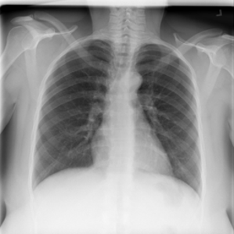
Introduction :
Project overview :
Our goal is to develop a deep learning model that can assist healthcare providers in identifying lung abnormalities quickly and accurately in a clinical setting. The model will focus on detecting COVID-19, Lung Opacities and Viral Pneumonia.
Notes:
Marwen
To start first Chest X-Ray is a common medical imaging modality used for diagnosing and monitoring conditions affecting the chest, such as lung infections, heart abnormalities, fractures, and other diseases.
Our main focus in this model is the lung.
There is a Need for Faster and Accurate Lung Abnormality Detection AI can bridge the gap with rapid diagnostics Improved accuracy.
Our goal is to Develop a deep learning model to Detect and classify COVID-19, Lung Opacities, and Viral Pneumonia and Assist clinicians in making accurate and timely diagnosis
Have your phone ready at the end of our presentation we will present you a Qr code to access and try our model .

Slide 3
Our objective :
Faster Diagnosis: Reduces manual workload for radiologists.
Increased Accuracy: AI-driven insights for better clinical decisions.
Scalability:
Can be deployed in hospitals and remote healthcare facilities.
Notes:
Marwen
Objectives of the Model is to Detect and classify COVID-19, Lung Opacities, and Viral Pneumonia
and there to
Assist clinicians in making accurate and timely diagnosis
Ensure scalability for real-world clinical settings
Maintain high precision and recall to minimize false negatives

Slide 4
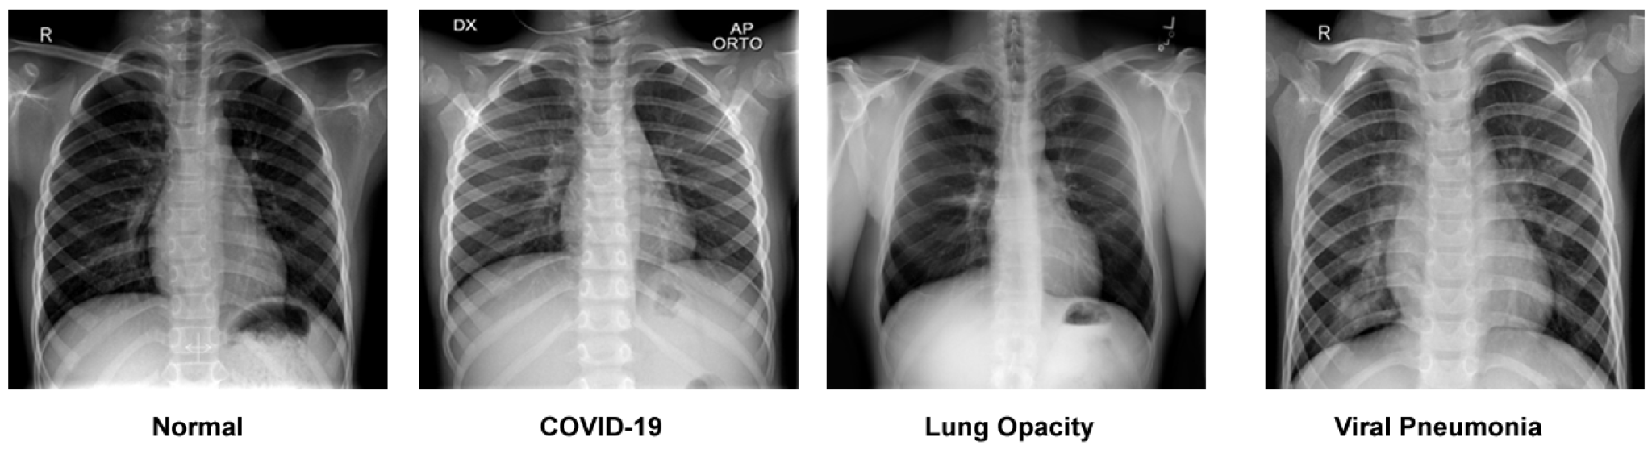
Dataset:
COVID-19 Radiography Database
Chest X-ray images Database
Notes:
Sean
The dataset we selected was the winner of the COVID-19 Dataset Award by the Kaggle Community.
It was curated by a team of researchers, in collaboration with medical professionals, to encompass a diverse collection of chest X-ray images that include cases of COVID-19, Non-COVID-19 infections (for example: lung opacity and viral pneumonia) and normal healthy lungs.
Displayed on the screen are representative examples of each classification, offering a visual understanding of the distinct features that define these conditions.
Next Slide

Slide 5
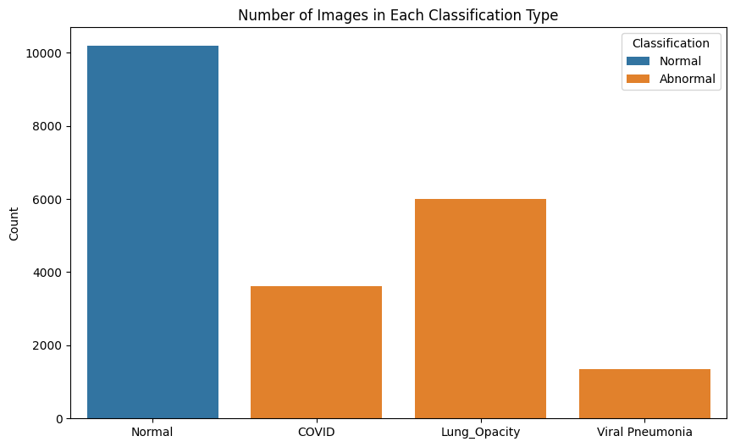
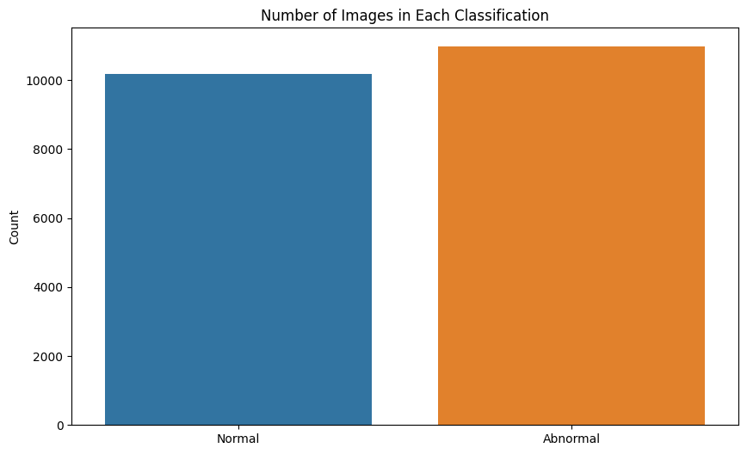
Data Exploration:
Notes:
Sean
Data Exploration
One of our initial discussions when we found this dataset centered on whether we should develop a method for directing the model’s focus specifically to the lungs.
However, due to the dataset’s substantial size, modifying each individual image was impractical.
Additionally, this decision reflects real-world conditions, where test images are not meticulously preprocessed.
By maintaining a realistic training and testing environment, we reduce the risk of overfitting to an artificially refined dataset, ultimately improving the model’s robustness and generalizability in real-world applications.
Upon the data exploration stage, we observed a significant class imbalance, as illustrated in the graph on the left side of your screen.
One critical challenge was the potential for over-representation of augmented Viral Pneumonia images, which could skew model performance.
To address this, we consolidated the COVID-19, Lung Opacity, and Viral Pneumonia categories into a single 'Abnormal' classification, as depicted in the graph on the right.
This restructuring not only mitigates dataset imbalance but also provides a practical framework for downstream decision-making, allowing for further diagnostic branching when an image is classified as abnormal.
And now I will turn it over to Anna to discuss Preprocessing

Slide 6
Preprocessing :
Original Image distribution across different labels:
Normal: 10,192
COVID-19: 3,616
Lung Opacities: 6,012
Viral Pneumonia: 1,345
Reorganized Imaged distribution across different labels:
Normal: 10, 192
Abnormal: 10,973
Notes:
Anna
combining the COVID, lung opacity, and viral pneumonia images = 10, 973

Slide 7

Preprocessing :
Colored vs Grayscale Images:
Color channels
3 for RGB
1 for grayscale
Resizing (with Lanczos):
from (299 x 299) to (128 by 128)
Shrinks without blurring
Resized
Converted to grayscale
Notes:
Some imaging systems or workflows default to saving images in RGB (Red-Green-Blue) formats, even if the image is purely grayscale.
Example: An X-ray saved as a PNG might have three identical color channels (R=G=B) to display grayscale values.
Visual Perception: While these images appear grayscale to the human eye, they are stored with redundant color channels, increasing file size without adding useful information.
Increases memory usage during training.
Lanczos-style filters are good for resizing images because they handle detailed graphics without blurring like cubic filters.
Preserves critical details for accurate feature extraction.
Ideal for tasks requiring edge detection (like medical images)

Slide 8
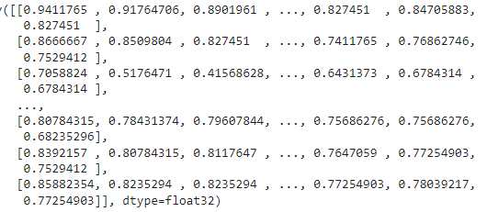
Preprocessing :
Numpy array as float
Models don’t understand images, they understand numbers
Array shape of (128,128)
Normalize
From values of 0 to 255 to values of 0 to 1
Saving as pickle (.pkl) file
Image as normalized numpy array
Notes:
Think of NumPy as a super-efficient way to handle numbers in Python. machine learning models don’t understand images—they understand numbers.
Converting to a NumPy array means:
The image becomes a grid of numbers (pixel values).
The model can process them much faster than using regular Python lists.
A grayscale image of size 128x128 becomes a NumPy array of shape (128, 128), where each number represents a pixel’s brightness.
The image pixels will have values from 0 to 255 . If we don’t normalize, some values will be too large, making training harder.
Normalizing (scaling pixel values between 0 and 1) helps:
Faster training: Smaller numbers make learning more stable.
Better accuracy: The model can learn patterns without being biased by large values.
Prevents exploding gradients (when numbers get too big and mess up training
Preprocessing (like resizing, normalizing, encoding labels) can take a long time. If you do it every time you train the model, it wastes time.
Saving as a .pkl (pickle) file means:
Instead of repeating preprocessing everytime we use our data, we can just load and use the preprocessed data
For us it took hours preprocessing our dataset.

Slide 9
Various Models
 | Image size | Accuracy | Loss
Model_299 | 299x299 | - | -
Model_128 | 128x128 | 95.65 % | 15.95 %
Model_64 | 64x64 | 91.5% | 20.43%
Model_32 | 32x32 | 88.13% | 28.18%
Branch_Model_32 | Accuracy | Loss
Binary Classification (Normal / Abnormal) | 94.42% | 16.41%
Multiclass Classification (Covid / Lung Opacity / Viral Pneumonia) | 45.56% | 15.05%
Notes:
Amar Talking Points for the Slide (1 min)
This slide evaluates the impact of image resolution on model performance and the results of our branching model approach.
There’s a clear trade-off between image resolution and dataset size—higher resolutions retain more detail but require more computation and memory, while lower resolutions allow for larger datasets and faster training at the cost of some accuracy.
Here, we chose resolution as the key lever, testing models at 128x128, 64x64, and 32x32 to balance performance and efficiency.
Model_128 (128x128) achieved the best balance with 95.65% accuracy and 15.95% loss, while Model_32 (32x32) had the lowest accuracy (88.13%), indicating a loss of critical features at lower resolutions.
For the Branching Model at 32x32:
Binary Classification (Normal vs. Abnormal) performed very well at 94.42% accuracy, confirming its reliability in detecting abnormalities.
However, Multi-Class Classification (COVID, Lung Opacity, Viral Pneumonia) had a lower accuracy of 45.56%, suggesting that finer distinctions between abnormal cases are harder at this resolution.
This highlights the trade-off between computational efficiency and diagnostic precision, where higher resolution may improve subtype classification at the cost of training speed and dataset size.

Slide 10
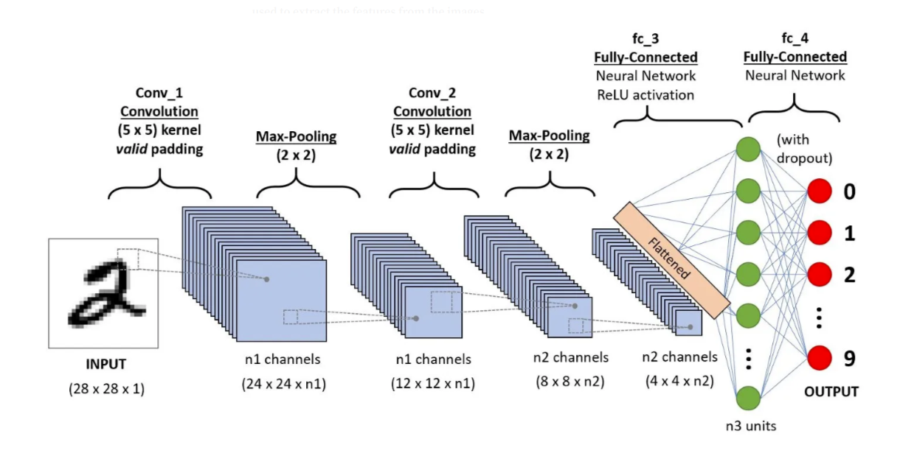
Hyper-Parameter Tuning
Hyperband
Number of Filters in Conv2D Layers
Kernel Sizes
Dense Layer Units
Learning Rate
Training data: 100 images
Testing data: 10 images
Accuracy 88.62%
Loss: 48.08 %
Notes:
Anna
Hyperband
Uses successive halving to allocate resources efficiently. Starts with many configurations, trains them briefly, eliminates the worst, and reallocates resources to promising ones.
By automatically stopping poorly performing trials early. It reduces computational cost and speeds up the tuning process.
Struggles with time and computational resources with tuning:
Had to do three different trials
First one on entire training set and testing : ran for over 18 hours and still going, would not make it in time
Second one on 1000 images training set and 200 for testing , timed out several time
Third trial 100 training images, 10 for testing
Shortens training time but may have been the main reason for the lower accuracy
Stride, batch size, larger training sets
Number of Filters in Conv2D Layers
Purpose: Filters detect patterns (edges, textures, shapes) in input images.
First Conv2D layer: Learns basic features (edges, gradients).
Deeper layers: Learn complex patterns (shapes, objects).
Impact:
Too few filters: Model misses important features → underfitting.
Too many filters: Model becomes computationally heavy and may overfit.
Kernel Size in Conv2D Layers
Purpose: The kernel (e.g., 3x3 or 5x5) determines the receptive field (how much of the input image the filter "sees").
Impact:
Small kernel (3x3): Focuses on fine details, preserves spatial resolution.
Large kernel (5x5): Captures broader patterns but may lose local details.
Purpose: The dense layer combines features extracted by convolutional layers for classification.
Impact:
Too few units: Model can’t learn complex relationships → underfitting.
Too many units: Risk of overfitting and slow training.
Purpose: Controls how much the model updates its weights during training.
Impact:
High learning rate: Updates weights aggressively → may overshoot optimal values.
Low learning rate: Slow convergence → longer training time.
Filters: Number of workers (too few → slow, too many → chaos).
Kernel Size: Tools each worker uses (small screwdriver vs. large wrench).
Dense Units: Quality control team (too small → errors, too large → inefficiency).
Learning Rate: Speed of the conveyor belt (too fast → mistakes, too slow → delays).

Slide 11

Challenges and If We Had More Time
Notes:
Sean
Challenges and if we had more time
We faced two major challenges:
As noted by my colleagues, the size of the dataset, with over 20,000 images, caused delays in performing hyperparameter tuning and running the model.
And Collab requires a certain version of TensorFlow to work properly.
I had ChatGPT generate the image on the screen to illustrate how my Sunday went when I was unable to figure out why our model was not running prior to discovering the tensorflow issue. At least the Eagles won.
If we had more time, we would have focused more on branching the abnormal images, applying ScoreCAM to identify the regions of the image that the model focuses on during predictions, and more time to play with experiment with different hyperparameters.
And now I will turn it over to Marwen to walk through a demonstration

Slide 12
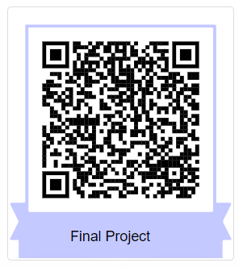
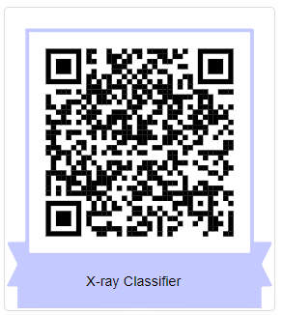
Thank You for Listening!
Our GitHub
Our User Interface
Notes:
https://f9d97209ed35404931.gradio.live
AI in Healthcare
Our model potential is to:
Save lives through early detection
Improve diagnostic accuracy
Enhance clinical workflows
Here is a real example of our model if you want to try it on by scanning the qr code presented

Slide 13
Dataset Source and reference
https://www.kaggle.com/datasets/tawsifurrahman/covid19-radiography-database
*****COVID-19 CHEST X-RAY DATABASE
A team of researchers from Qatar University, Doha, Qatar, and the University of Dhaka, Bangladesh along with their collaborators from Pakistan and Malaysia in collaboration with medical doctors have created a database of chest X-ray images for COVID-19 positive cases along with Normal and Viral Pneumonia images. This COVID-19, normal and other lung infection dataset is released in stages. The database has 3616 COVID-19 positive cases along with 10,192 Normal, 6012 Lung Opacity (Non-COVID lung infection) and 1345 Viral Pneumonia images and corresponding lung masks.
References tied to the dataset reuse license:
M.E.H. Chowdhury, T. Rahman, A. Khandakar, R. Mazhar, M.A. Kadir, Z.B. Mahbub, K.R. Islam, M.S. Khan, A. Iqbal, N. Al-Emadi, M.B.I. Reaz, M. T. Islam, “Can AI help in screening Viral and COVID-19 pneumonia?” IEEE Access, Vol. 8, 2020, pp. 132665 - 132676.
Rahman, T., Khandakar, A., Qiblawey, Y., Tahir, A., Kiranyaz, S., Kashem, S.B.A., Islam, M.T., Maadeed, S.A., Zughaier, S.M., Khan, M.S. and Chowdhury, M.E., 2020. Exploring the Effect of Image Enhancement Techniques on COVID-19 Detection using Chest X-ray Images. arXiv preprint arXiv:2012.02238.

